Slide 1
CMR College of Engineering & Technology
(UGC Autonomous)
Accredited by NAAC with “A” Grade
Kandlakoya, Medchal Road, Hyderabad-501401
Department of Computer Science & Engineering
Prediction of Parkinson’s disease and severity of the disease using Machine Learning and Deep Learning algorithm
Batch Number:B61
Guide Name: Dr. Sendhil
19H51A0521-R.Rakshith Reddy
19H51A0522-R.Satya raj
19H51A05K3-G.Ganendhar
CMRCET - CSE

Slide 2
Contents
Abstract
Introduction
Literature Survey
Existed System
Problem definition
Research Work
Performance Measure
Results
Conclusion
Future Work
References
CMRCET - CSE

Slide 3
Abstract
Parkinson’s disease is a neurodegenerative disease which worsens over time.
People have trouble vocally, writing, strolling, or completing other simple tasks when dopamine generating neurons in parts of the brain become impaired or expire.
These symptoms worsen over time, increasing the severity of the condition in patients.
We have suggested a methodology in this article for the prediction of Parkinson’s disease severity using deep neural networks on UCI’s Parkinson’s Telemonitoring Vocal Data Set of patients.
We have created a neural network to predict the severity of the disease and a machine learning model to detect the disorder.
Classification of Parkinson’s Disease is done by Neural network, Random Forest Classifier.
CMRCET-CSE

Slide 4
Introduction
Parkinson’s disease (a neurodegenerative disorder) that causes the patients’ motor abilities to degrade over time due to the damage caused to the dopamine-generating brain cells. Shaking, trouble moving, behavioral disorders, dementia, and depression are some of the results of this disorder. The primary motor conditions are referred to as ”Parkinsonism,” or a ”Patient with Parkinson’s Disease.” One of the most common symptom that can be recognized by studying the patients’ voice data is changes in their voice. The patient’s speech stutters and becomes increasingly impacted as the disease progresses. Deep learning has risen in importance as a method for analyzing unstructured data such as speech and audio signals. Multiple layers of neurons are often used I deep neural networks, these layers are stacked as a single unit for classification and feature selection models. Deep learning is being used in this paper to classify the patient’s voice data into ”extreme” and ”not severe” categories. The two UPDRS (Unified Parkinson’s Disease Rating Scale) scores - total UPDRS and motor UPDRS - were used as assessment criteria in this study. The motor UPDRS assesses the patient’s motor capacity in the scale of 0-108, while the total UPDRS assesses the patient’s overall ability and its score range from 0-176.
CMRCET-CSE

Slide 5
Literature Survey
1) A comparison of multiple classification methods for diagnosis of Parkinson disease
AUTHORS: ResulDas
In this paper, different types of classification methods are compared for effective diagnosis of Parkinson’s diseases. The reliable diagnosis of Parkinson’s disease is notoriously difficult to achieve with misdiagnosis reported to be as high as 25% of cases. The approaches described in this paper purpose to efficiently distinguish healthy individuals. Four independent classification schemas were applied and a comparative study was carried out. These are Neural Networks, DMneural, Regression and Decision Tree respectively. Various evaluation methods were employed for calculating the performance score of the classifiers. According to the application scores, neural networks classifier yields the best results. The overall classification score for neural network is 92.9%. Moreover, we compared our results with the result that was obtained by kernel support vector machines [Singh, N., Pillay, V., & Choonara, Y. E. (2007). Advances in the treatment of Parkinson’s disease. Progress in Neurobiology, 81, 29–44]. To the best of our knowledge, our correct classification score is the highest so far.
CMRCET - CSE

Slide 6
Literature Survey
2) Predicting Severity Of Parkinson's Disease Using Deep Learning
AUTHORS: Srishti Grover, Saloni Bhartia, Akshama, Abhilasha
Parkinson's disease is a progressive and chronic neurodegenerative disorder. As the dopamine-generating neurons in parts of the brain become damaged or die, people begin to experience difficulty in speaking, writing, walking, or completing other simple tasks. These symptoms grow worse over time, thus resulting in the increase of its severity in patients. In this paper, we have proposed a methodology for the prediction of Parkinson’s disease severity using deep neural networks on UCI’s Parkinson’s Telemonitoring Voice Data Set of patients. We have used ‘TensorFlow’ deep learning library of python to implement our neural network for predicting the severity. The accuracy values obtained by our method are better as compared to the accuracy obtained in previous research work.
CMRCET - CSE

Slide 7
Literature Survey
3) UPDRS tracking using linear regression and neural network for Parkinson’s disease prediction
AUTHORS : Elmehdi BENMALEK , Jamal ELMHAMDI , Abdelilah JILBAB
The Unified Parkinson’s Disease Rating Scale (UPDRS) is often used to track Parkinson's disease (PD) but it requires costly and logistically inconvenient for patient and clinical staff. In this work we present clinically useful accuracy replication of UPDRS, so we can classify the disease’s severity of the patients with, and predict the evolution of PD based on those results. We map the features extracted from the speech to UPDRS using Least-squares regression technique and neural network. We applied our techniques on large database of PD speech (~6,000 recordings from 42PD patients). And we compare our results with state of the art.

Slide 8
Literature Survey
4) Predicting Severity Of Parkinson’s Disease Using Deep Learning
AUTHORS : SrishtiGroverSaloniBhartiaAkshama
Parkinson’s disease is a progressive and chronic neurodegenerative disorder. As the dopamine-generating neurons in parts of the brain become damaged or die, people begin to experience difficulty in speaking, writing, walking, or completing other simple tasks. These symptoms grow worse over time, thus resulting in the increase of its severity in patients. In this paper, we have proposed a methodology for the prediction of Parkinson’s disease severity using deep neural networks on UCI’s Parkinson’s Telemonitoring Voice Data Set of patients. We have used ‘TensorFlow’ deep learning library of python to implement our neural network for predicting the severity. The accuracy values obtained by our method are better as compared to the accuracy obtained in previous research work.

Slide 9
Literature Survey
5) High-accuracy detection of early Parkinson's Disease using multiple characteristics of finger movement while typing
AUTHORS : Warwick R. Adams
Parkinson’s Disease (PD) is a progressive neurodegenerative movement disease affecting over 6 million people worldwide. Loss of dopamine-producing neurons results in a range of both motor and non-motor symptoms, however there is currently no definitive test for PD by non-specialist clinicians, especially in the early disease stages where the symptoms may be subtle and poorly characterised. This results in a high misdiagnosis rate (up to 25% by non-specialists) and people can have the disease for many years before diagnosis. There is a need for a more accurate, objective means of early detection, ideally one which can be used by individuals in their home setting. In this investigation, keystroke timing information from 103 subjects (comprising 32 with mild PD severity and the remainder non-PD controls) was captured as they typed on a computer keyboard over an extended period and showed that PD affects various characteristics of hand and finger movement and that these can be detected. A novel methodology was used to classify the subjects’ disease status, by utilising a combination of many keystroke features which were analysed by an ensemble of machine learning classification models. When applied to two separate participant groups, this approach was able to successfully discriminate between early-PD subjects and controls with 96% sensitivity, 97% specificity and an AUC of 0.98. The technique does not require any specialised equipment or medical supervision, and does not rely on the experience and skill of the practitioner. Regarding more general application, it currently does not incorporate a second cardinal disease symptom, so may not differentiate PD from similar movement-related disorders.

Slide 10
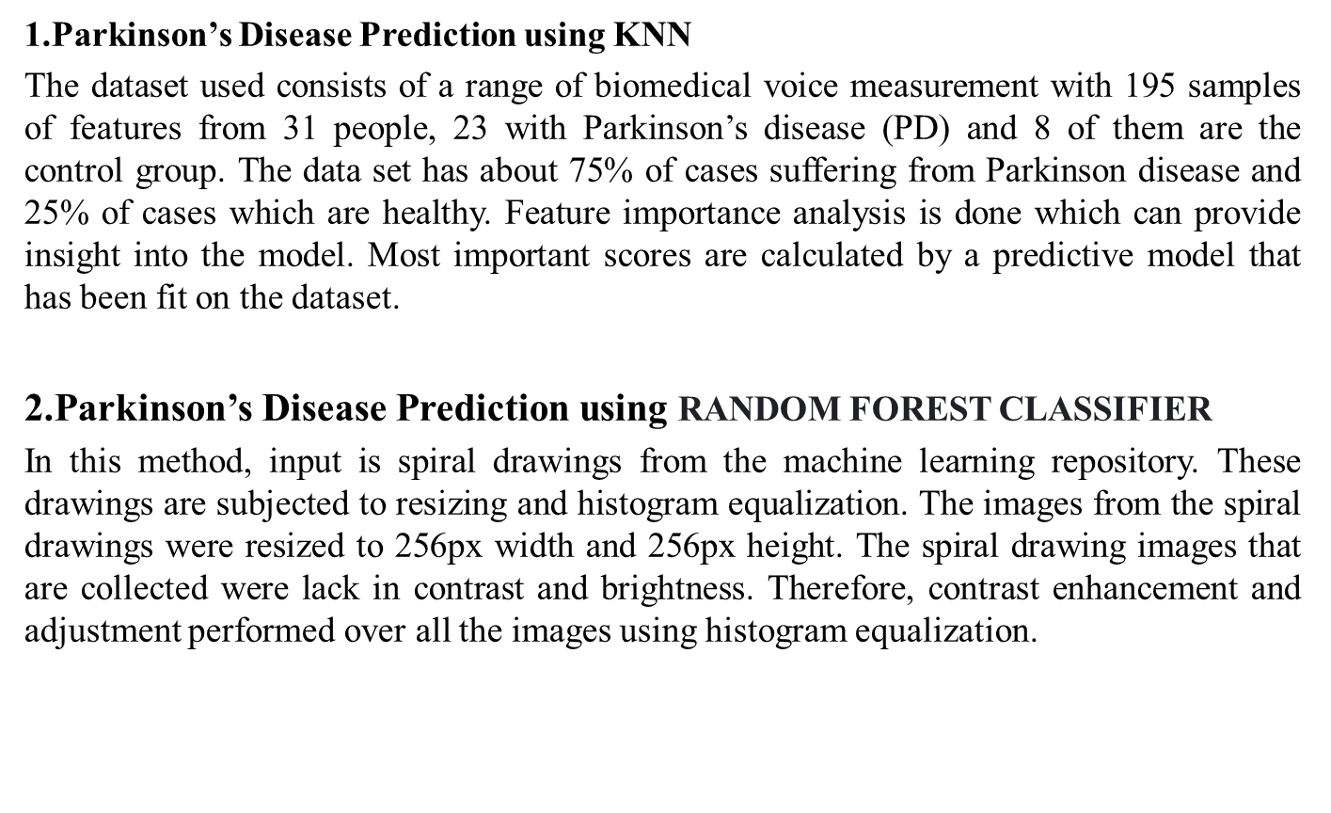
Existing System
CMRCET-CSE

Slide 11
Existing Works
DISADVANTAGES OF EXISTING SYSTEM:
A huge number of methodologies of available algorithms are not appropriate to aid professionals under the different area, highly depends on the employed statistics, therefore, struggle to maintain recitation with the variation of data properties.
The majority of the algorithms intended to accomplish only a specific task hence does not fit for the real-time scenario where the cost is one of the primary factors
CMRCET - CSE

Slide 12
Problem Definition
Parkinson’s disease is a neurodegenerative disease which worsens over time. People have trouble vocally, writing, strolling, or completing other simple tasks when dopamine generating neurons in parts of the brain become impaired or expire. These symptoms worsen over time, increasing the severity of the condition in patients. We have suggested a methodology in this article for the prediction of Parkinson’s disease severity using deep neural networks on UCI’s Parkinson’s Telemonitoring Vocal Data Set of patients. We have created a neural network to predict the severity of the disease and a machine learning model to detect the disorder. Classification of Parkinson’s Disease is done by Neural network.
CMRCET - CSE

Slide 13
Research Work
Proposed System
The proposed work, there are four different classification algorithms were selected along with the two feature compressing methods as CFS with best-first search and Gain ratio with ranker mechanism. As described in the literature survey each algorithm is designed with an obtainable process in an optimized form, such a selected process may not be utilized to build a more competent method. The proposed method investigate and analyze four chosen method such as Hidden Markov Model (HMM), Artificial Neural Network (ANN), Support Vector Machine (SVM) and Decision Tree (J48) along with two other feature compressing methods. [2, 17] After analyzing these feature compressing methods, combine them with the linear models. And if any data is mismatched then reexamine with the other employed technique to improve the QoS.
ADVANTAGES OF PROPOSED SYSTEM:
The comparative values show that the proposed method obtains higher accuracy when compared with other existing methods.
The efficiency and suitability of the proposed approach are compared with other suggested methods.
.
CMRCET-CSE

Slide 14
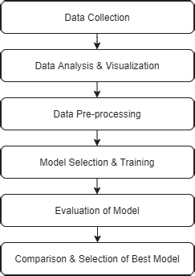
Proposed System
SYSTEM ARCHITECTURE:
CMRCET-CSE

Slide 15
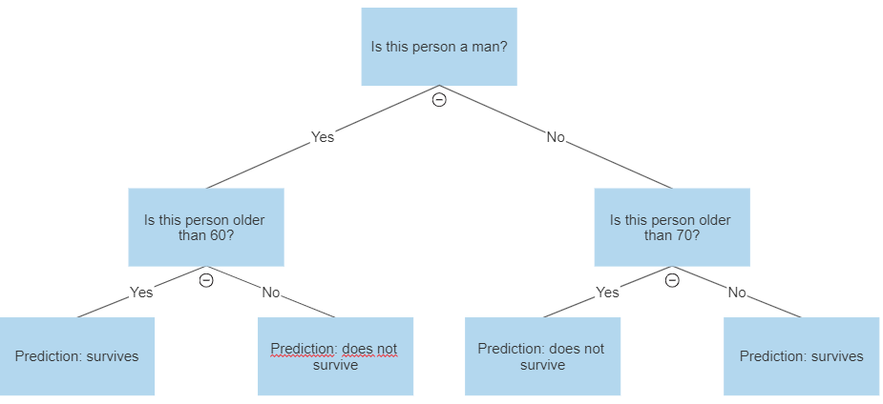
Algorithms used/ Techniques used
Algorithm Used/Techniques Used:
1.XGBOOST ALGORITHM - eXtreme Gradient Boosting Algorithm
2.Decision tree
CMRCET-CSE

Slide 16
Comparison of proposed with existing System
CLASSIFICATION TECHNIQUES | TRAINING ACCURACY RATE | TEST ACCURACY RATE
Logistic Regression | 0.88 | 0.79
Decision Tree | 1.0 | 0.87
SVM | 0.89 | 0.9
KNN | 0.94 | 0.92
Existing System
Proposed system
CMRCET - CSE

Slide 17
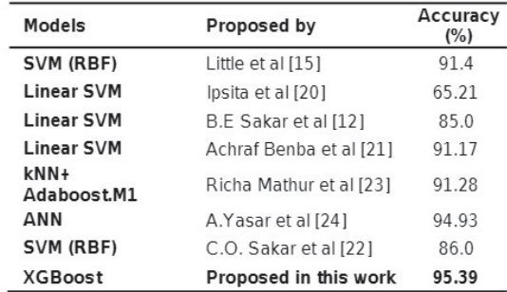
Performance Measure
CMRCET - CSE

Slide 18
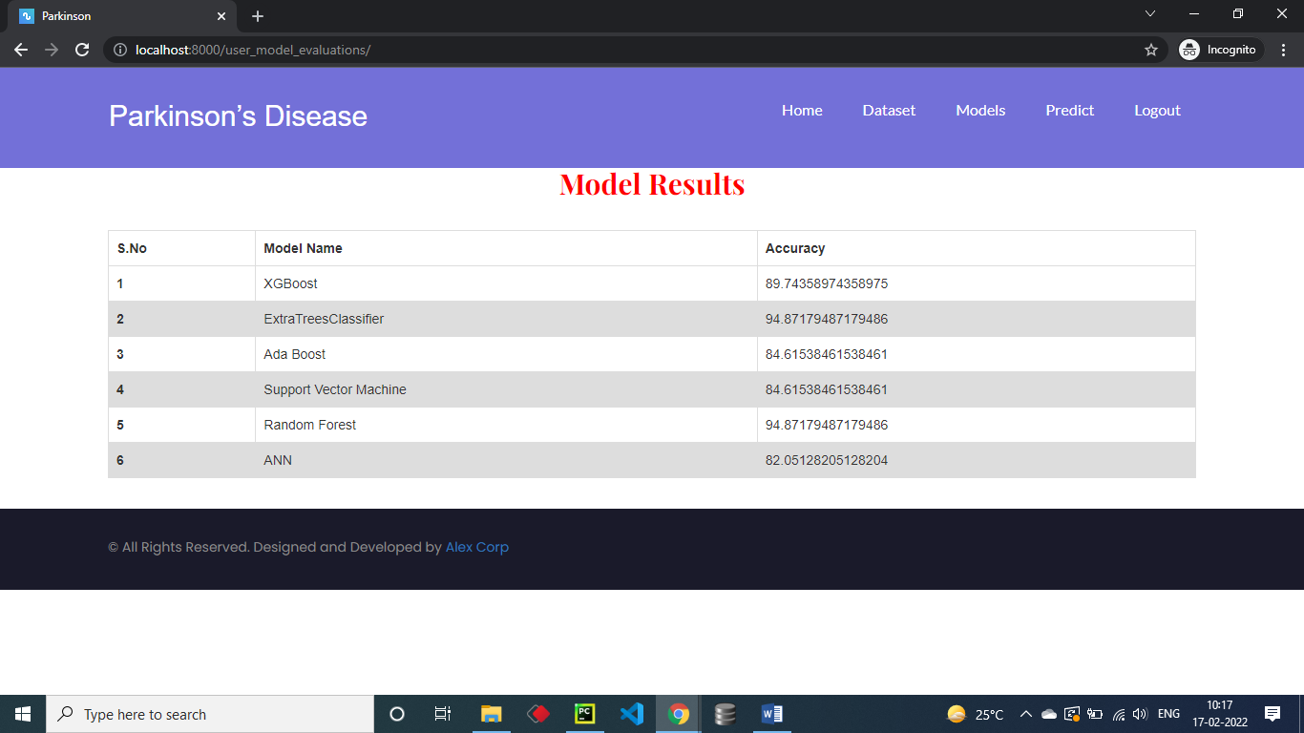
Results
User View Results
CMRCET - CSE

Slide 19

Admin View Results
CMRCET - CSE

Slide 20
CONCLUSION
Detection of Parkinson’s Disease
1) The research area for Parkinson’s Disease is significant, early stage detection of it can improve patient’s health.
2) This solution was capable of differentiating among early stage Parkinson disease subjects and controls with a tolerance of 92 to 100 %, a specificity of 95 to 100 % and an AUC(Area Under Curve) in the range of 0.97 and 1.00.
3) It was found that Parkinson’s disease was detected positive in people above the age of 55 years.
4) According to the study, females are more likely to have Parkinson’s than males.
CMRCET-CSE

Slide 21
Future Work
The study was done to detect and severity of Parkinson’s disease using a single model for each purpose. The study can be further extended by using other models and comparing the results to find the most optimised and efficient models for detection of disease and to determine the severity of the disease in the patient.
It can be concluded that the prognostication of Parkinson’s Disease is very complex and is dependent on many variable factors which keeps on changing. If the features are properly selected we can get an optimized and efficient model which can get proper severity and extent of the spread of disease in the patient.
CMRCET - CSE

Slide 22
References
[1] Das R. “Comparison of multiple classification methods for diagnosis of Parkinson disease”. Expert Systems With Applications, 37:1568–1572, 2010.
[2] Genain N, Huberth M, and Vidyashankar R. “Predicting Parkinson’s Disease Severity from Patient Voice Features.” 2014.
[3] Benmalek E, Elmhamdi J, and Jilbab A. “UPDRS tracking using linear regression and neural network for Parkinson’s disease prediction.” International Journal Of Emerging Trends and Technology In Computer
Science, 4:189–193, 2015.
[4] Seeja K.R., Srishti Grover, Saloni Bhartia, Akshama, and Abhilasha Yadav. “Predicting Severity Of Parkinson’s Disease Using Deep Learning”. Procedia Computer Science, 132:1788–1794.
[5] Warwick R. Adams. “High-accuracy detection of early Parkinson’s Disease using multiple characteristics of finger movement while typing”. 2017.
[6] Cole B, Roy S, De Luca C, and Nawab S. “Dynamical Learning and Tracking of Tremor and Dyskinesia From Wearable Sensors.” IEEE Transactions On Neural Systems And Rehabilitation Engineering, 22:982–991, 2018.\
[7] Python machine learning course.
[8] Deep learning course.
[9] Multiple output neural networks.
CMRCET - CSE

Slide 23

CMRCET - CSE

